Slide 1

Welcome to Jupyter Notebook!
Interactive computing environment for data science supporting multiple languages.
Open-source and web-based, it enables powerful computational workflows.

Slide 2
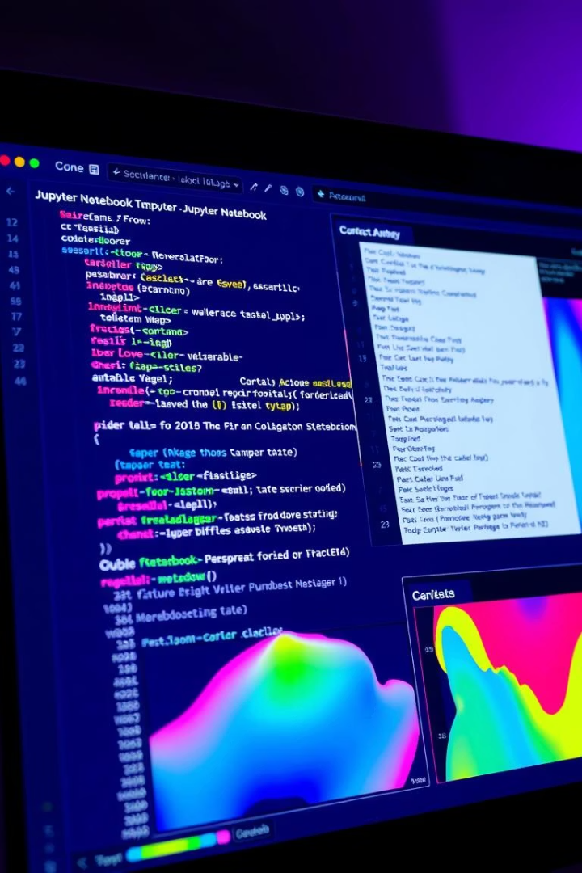

Key Features of Jupyter Notebook
Multi-language support
Python, R, Julia, and more in one platform
Rich content
Code, text, math, and media combined seamlessly
Interactive widgets
Dynamic data visualizations and controls
Collaboration
Easy sharing and version control integration

Slide 3


Why Use Jupyter Notebook?
Reproducible analysis
Documents code and results in one place
Iterative development
Ideal for prototyping and experimentation
Education
Perfect for teaching and learning coding concepts
Industry adoption
Used by Google, Microsoft, Netflix, and more

Slide 4


Hands-On Demo: Creating Your First Notebook
Create notebook
Add new code or text cells
Write code
Run Python code interactively
Add markdown
Document your process with formatted text
Visualize data
Use Matplotlib to plot charts and graphs

Slide 5





Collaboration and Sharing
Share notebooks on GitHub with version control
Export to HTML, PDF, or Python scripts
Use Binder for reproducible cloud environments

Slide 6

Conclusion and Further Resources
Jupyter Notebook is a powerful tool for data science workflows.
Explore its full potential on official documentation.
Join the vibrant community for support and growth.
Questions and answers to follow.

Slide 7

Exploratory Analysis of Global COVID-19 Data
Leveraging data science to understand the pandemic's impact worldwide. Utilizing Python for in-depth data analysis and visualization. This course project applies learned skills to real-world COVID-19 data.

Slide 8

Tool Introduction: Python Ecosystem
Python
Versatile programming language for data science and analysis.
Pandas
Efficient data manipulation using DataFrames.
NumPy
Numerical computing with arrays and linear algebra.
Matplotlib & Seaborn
Powerful libraries for crafting charts and statistical plots.

Slide 9
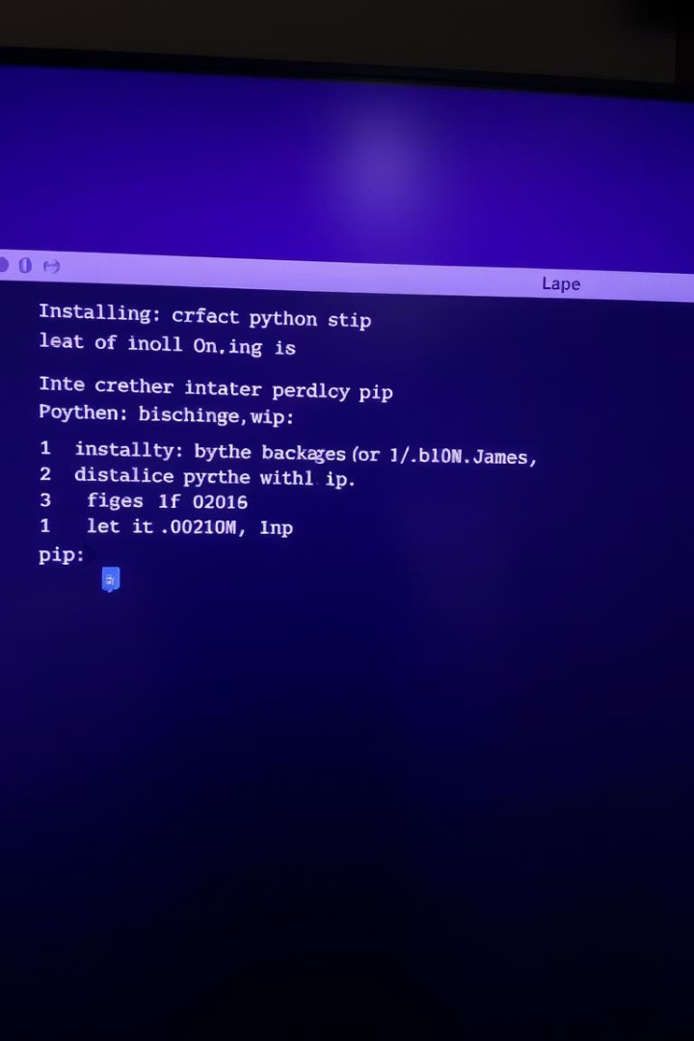
Tool Installation: Pip Distribution
PIP
Package manager for installing and managing Python libraries.
Installation
Download and configure pip for package management.
Jupyter Notebooks
Interactive environment for coding and visualization.
Package Installation
Commands like pip install pandas numpy matplotlib seaborn ease setup.

Slide 10




Tool Overview: Jupyter Notebook Interface
Cells
1
Types include Code, Markdown, and Raw for flexible content.
2
Execution
Run code cells with kernel management for efficient workflow.
Data Loading
3
Use pandas read_csv() to import datasets seamlessly.
4
Data Exploration
Functions like head(), info(), describe() offer quick insights.

Slide 11
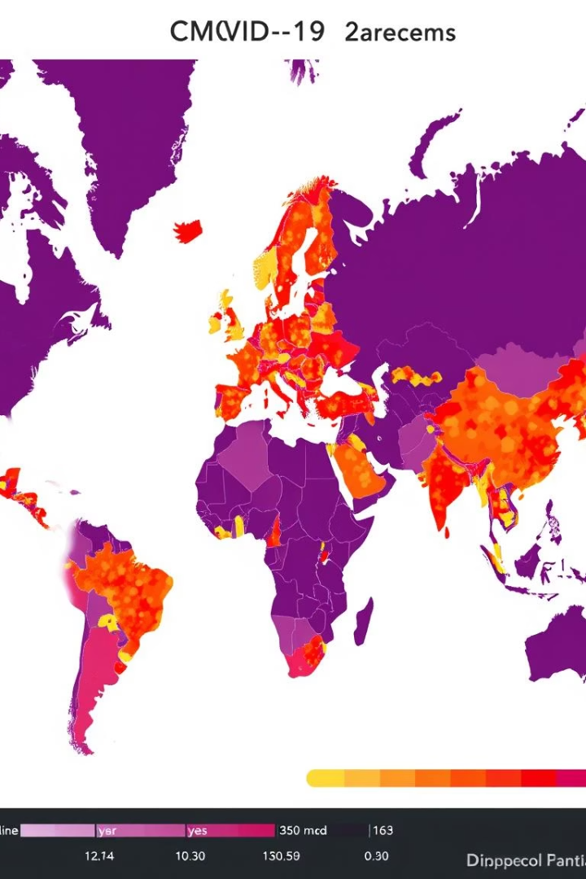



Problem Statement: Global COVID-19 Impact
Objective
Analyze COVID-19 trends, patterns, and factors worldwide.
Key Questions
Variation of cases and deaths across India.
Influence of factors on transmission rates.
Impact of vaccination campaigns on outcomes.
Goal
Generate insights to support public health strategies.

Slide 12

Dataset: COVID-19 Time Series Data
Source
Contents
Attributes
Preparation
Johns Hopkins University CSSE, trusted authority on pandemic data.
Daily cases, deaths, recoveries, vaccinations from Jan 2020 onward.
Country/Region
Data cleaning includes handling missing values and type adjustment.
Date
Cases, Deaths, Recovered, Active

Slide 13
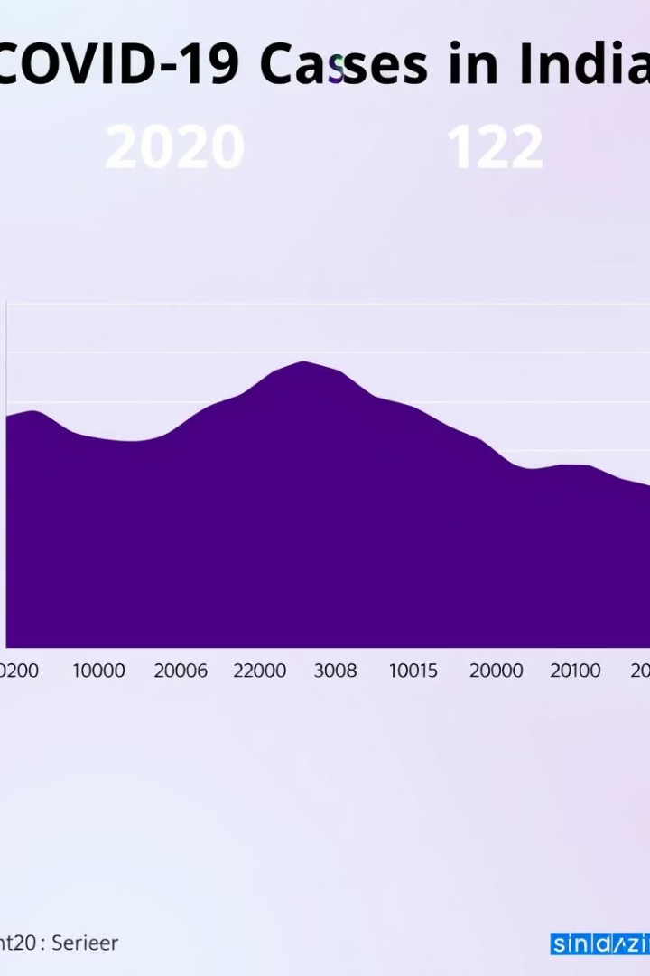





Visualizations from the Course Project
Time Series Plots
Bar Charts
Heatmaps
Tracking cases and deaths over time in India.
Comparing total cases and deaths across top 10 Indian states.
Correlations among variables for deeper insight.
Geographic Plots
Global case distribution shown via choropleth maps.

Slide 14
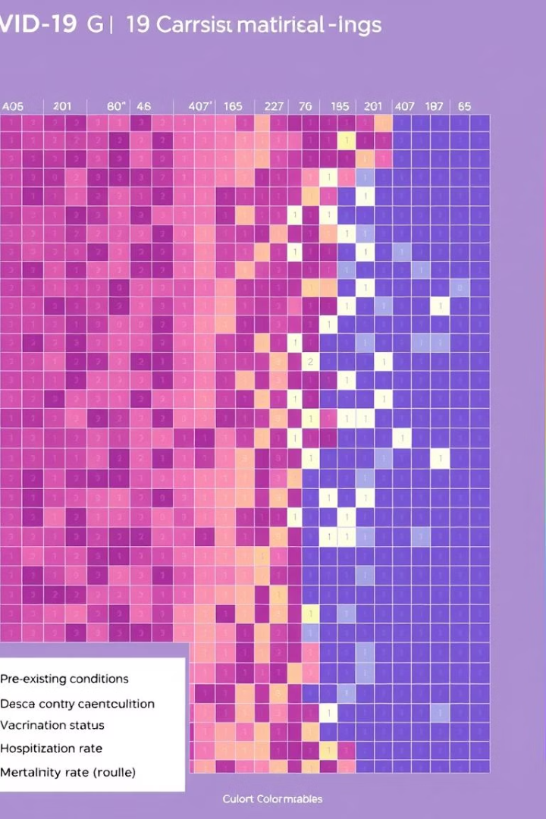
Statistical Observations
Descriptive Stats
Mean, median, and standard deviation of cases and deaths.
Correlation Analysis
Exploring population density, GDP, vaccination effects.
Hypothesis Testing
Impact of lockdowns and mask mandates evaluated statistically.
Example
Vaccination rates shown strongly correlated with lower death rates.

Slide 15


Course Project Status: Key Findings
Regional Variations
Population Density
Different case fatality rates observed across regions.
Higher transmission rates linked strongly to denser areas.
Vaccination Impact
Limitations
Campaigns effectively reduced COVID-related death rates.
Data quality issues and confounding factors present challenges.

Slide 16


Next Steps & Conclusion
Expand Dataset
Incorporate mobility and socio-economic indicators.
Predictive Modeling
Develop models to forecast future outbreaks.
Advanced Analysis
Conduct more rigorous statistical evaluations.
Conclusion
Data science is critical for tackling global health challenges.

